Slide 1
Iran
By wells, megan, and Jacob
Notes:
Background image is of the Mosque of Khorramshahr

Slide 2
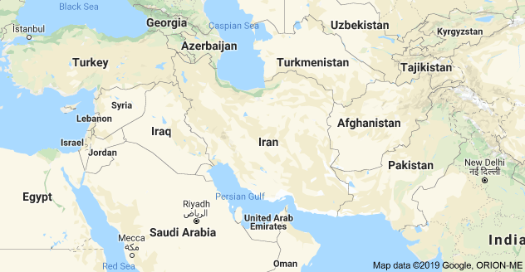
Notes:
Land borders: Iraq, Azerbaijan, Turkmenistan, Afghanistan, Pakistan, Armenia
Bodies of water: Caspian Sea, Persian Gulf, Gulf of Oman

Slide 3
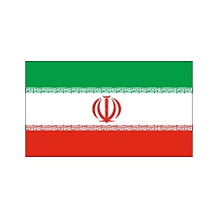
Notes:
Flag of Iran
Green represents Islam, white represents peace, red represents courage
Central symbol represents the 5 pillars of Islam

Slide 4
By Statistics
Capital: Tehran
President: Hassan Rouhani (2013- present)
Supreme Leader: Ali Hoseuni-Khameini
Population: Approx. 83 mil
Size: roughly 2.5x the size of Texas
Official language: Persian
Official Religion: Shia Muslim (95%)

Slide 5
History
1941: Reza Shah Pahlavi installed by Britain and the Soviet Union
Westernization
1953 Coup
Revolution of 1979
Reza Shah Pahlavi overthrown by the Islamist movement
US embassy in Tehran attacked, 52 diplomats held hostage for 444 days
Iran-Iraq War (1980-1988)
Notes:
1953: Shah deposed, Mohammed Mossadegh (nationalist) democratically elected but then CIA-organized coup reinstalls the Shah
1979: Shah perceived as puppet of the West, backlash to Westernization, poor economy, arbitrary detention and imprisonment of political opponents, didn’t handle protests well (fired live ammo, shot thousands of Iranians)
War: 500k-1M Iranians died, many from chemical weapons used by Iraq (led by Saddam Hussein). War lasted 1980-1988

Slide 6
Government
Theocratic Republic
Executive branch
Supreme leader, a "learned religious scholar."
President
Legislative Branch
Majles
Council of Guardians
Judicial
Supreme court with subordinate courts
Notes:
Supreme Leader: chosen for life by the Assembly of Experts
President: chosen by majority vote, serves 4-year term
Majles: Is an Islamic assembly, can pass laws
Council of Guardians: All candidates for the Majles must be nominated by the Council of guardians
12-person group, 6 of which are chosen by the supreme leader, the rest by judiciary committee, then the members are directly elected
The council also reviews laws passed by the Majles can veto them
Subordinate courts include the Penal Courts I and II

Slide 7
Economy
Heavily reliant on oil and petrochemical exports
Mixed economy
Statist policy
Market policy
Exchange rate is $1.00 USD to 42,105.00 Rial (Morningstar, 9/10/19)
Major trading partners: China, India, and the United Arab Emirates
Notes:
In Feb 2019, Iran claimed that it had recoverable crude oil reserves of 160 billion barrels, and recoverable natural gas reserves of 33.33 trillion cubic feet (oilprice.com)
Mixed economy: combines planned and market economies
Iran directly owns hundreds of state-owned enterprises and indirectly controls many companies affiliated with the country's security forces

Slide 8
Current Events
July 2015: Joint Comprehensive Plan of Action (2015) (JCPOA)
May 2018: US withdraws from JCPOA
May 2019: Iran announces intent to abandon JCPOA
Notes:
JCPOA: Iran agreed to delay its nuclear program: not engage in R&D for nuclear weapons, idle centrifuges, keep uranium enrichment % low
In return, $100B of Iranian assets overseas were unfrozen and Iran could trade on international oil markets again
Sept 5 2019: Iran announces it will do “whatever is needed to accelerate uranium enrichment”

